Slide 1
AI Placement Mentor
VISIONX
Team ID
H26EDU14
Project Title
AI Placement Mentor
Team Lead
Monica Sherlin P
Team Members
Monica Sherlin P, Rithuvarjitha VL
College Name
VIT Chennai
Project Overview
AI Placement Mentor is an AI-powered platform that helps students prepare for campus placements through personalized guidance. It analyzes a student's profile and resume, identifies skill gaps, generates a customized learning roadmap, and provides AI-based mentoring to improve placement readiness and interview performance.

Slide 2
Problem Statement & Objectives
The Problem
Our Objectives
A lot of students who are trying to get placements at colleges face certain challenges since there is no proper guidance given to them and they do not have any proper preparation strategy. The major challenge faced by most of the students is that they don't know the areas where they require improvement and what should be the preparation for particular companies.
Key challenges
They are unaware of skill gaps.
No personalized mentoring for placements.
General learning content is not role-specific.
No proper plan for placement preparation.
Difficulty comprehending expectations of recruiters.
This project seeks to:
Analyze the student’s profile and resume through AI.
Find strengths and areas of skill deficiency.
Develop an individual learning path.
Provide a readiness score for placements.
Simulate feedback from the recruiter for specific companies.
Facilitate campus placements through efficient preparation.

Slide 3
Existing Solutions & Identified Gaps
Solution | What It Does | Limitation
ChatGPT | Gives general career advice | Not personalized to the student
Resume Worded | Checks resume for keywords | No skill or interview guidance
Rezi AI | Helps build a resume | Only works on resumes
LinkedIn Learning | Offers many courses | Doesn't tell what to learn first
Coursera | Offers structured courses | Not linked to placement readiness
Gaps We Found
The students get general suggestions rather than customized advice.
There is no system that will provide resume building, identifying skill gaps, and placement preparation in one place.
Current systems do not monitor the progress of the students.
Students are not aware of their level of readiness for a certain organization.
A number of websites are required for resume building, training, and interviewing.
VISIONX | AI Placement Mentor | Slide 3

Slide 4
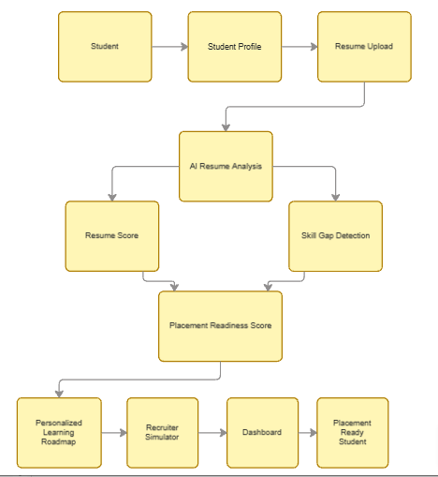
System Design
Student
VISIONX | AI Placement Mentor | Slide 4

Slide 5
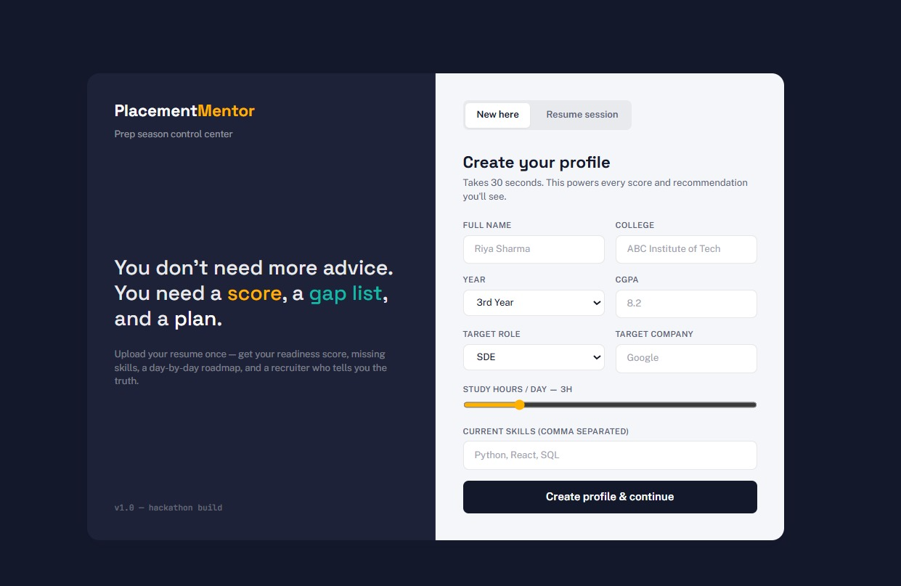
Implementation Progress
What We Have Built So Far
Screens
User Authentication
Student Profile Management
Resume Upload and PDF Parsing
AI-based Resume Analysis and Skill Gap Detection
Placement Readiness Score Generation
Expected outcomes
Better placement preparation
Improved interview confidence
Personalized guidance
Higher placement readiness
VISIONX | AI Placement Mentor | Slide 5

Slide 6
